Slide 1
Propose for Scrap Asset: Product End of Life 320008010411/ 8000007892
Grace Ng (LOG SS OE)

Slide 2
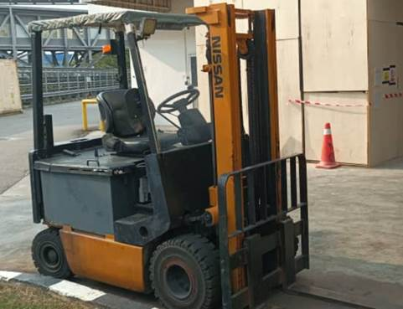
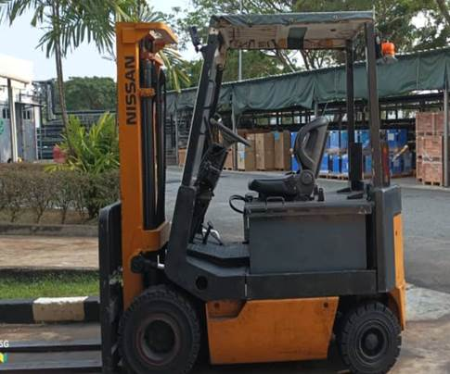
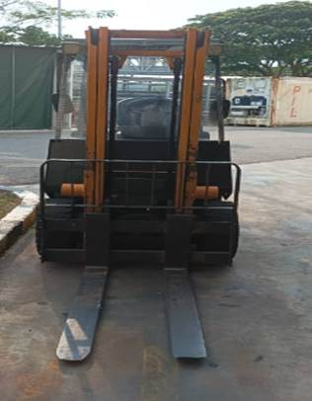
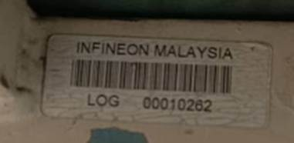
Propose for Sale: Asset No: 320008009597/ A000010262
PIO Asset number | P88 Asset number | Description | CC | Location | Cap Date | Acq Val (MYR) | NBV
320008009597 | A000010262 | NISSAN FORKLIFT-UM02L20U | 3200A29615 | LOG Ground Floor | 1/5/1995 |  | 0
Reason for scrap
Machine is close to 29 years and the repair cost is costly.

Slide 3
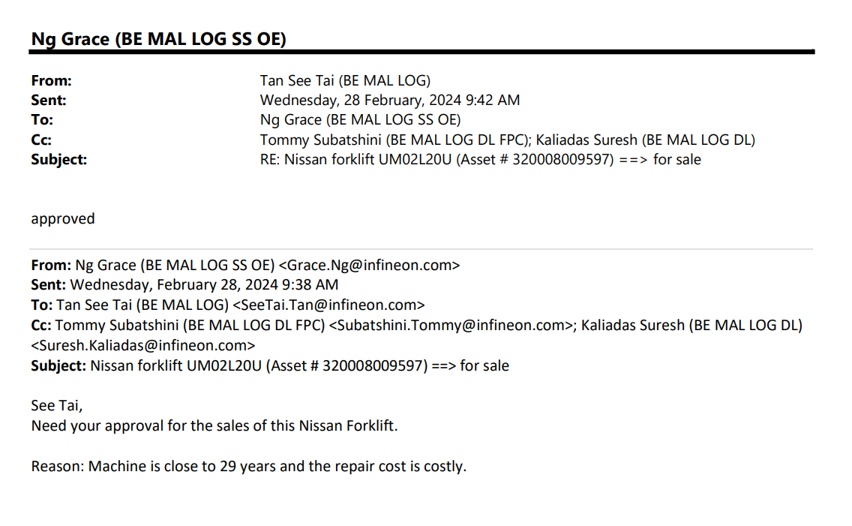
Email approval from HOD – Mr Tan See Tai

